Slide 1
ARAMAT (band website)
Project Summary
Gary Lam Ka Fung
Madeliene Edwards

Slide 2
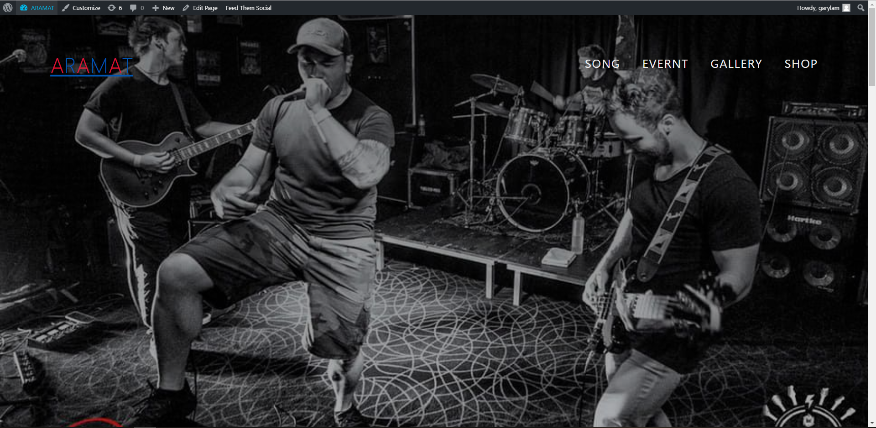
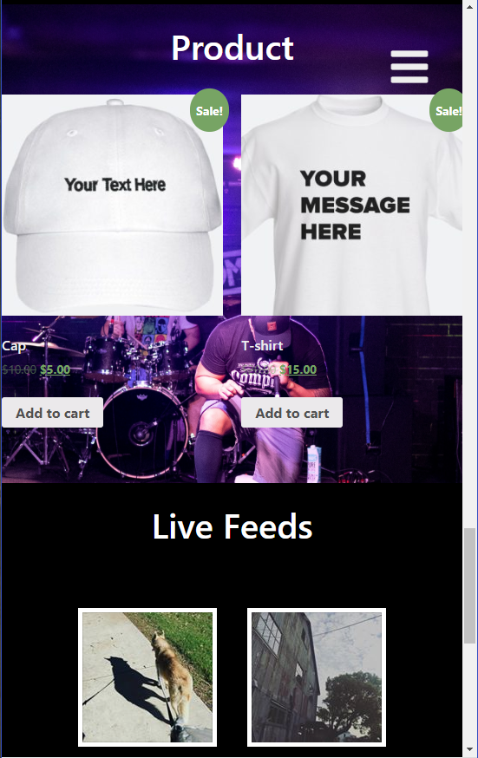
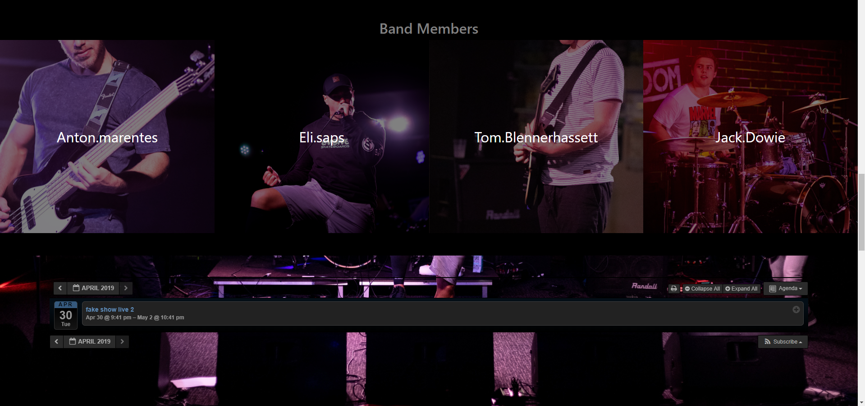
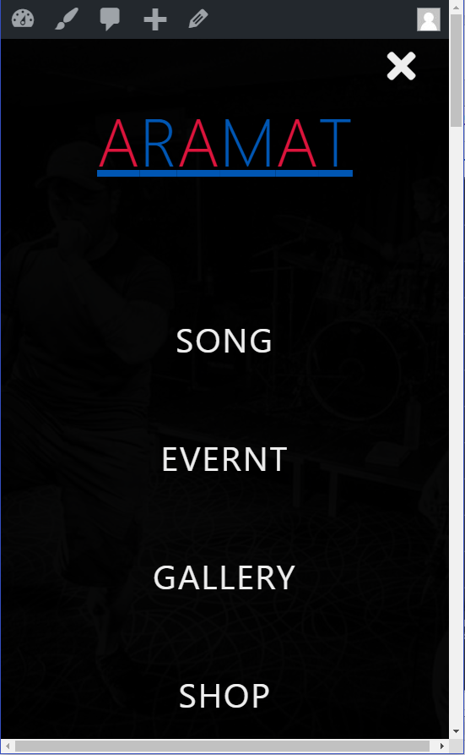
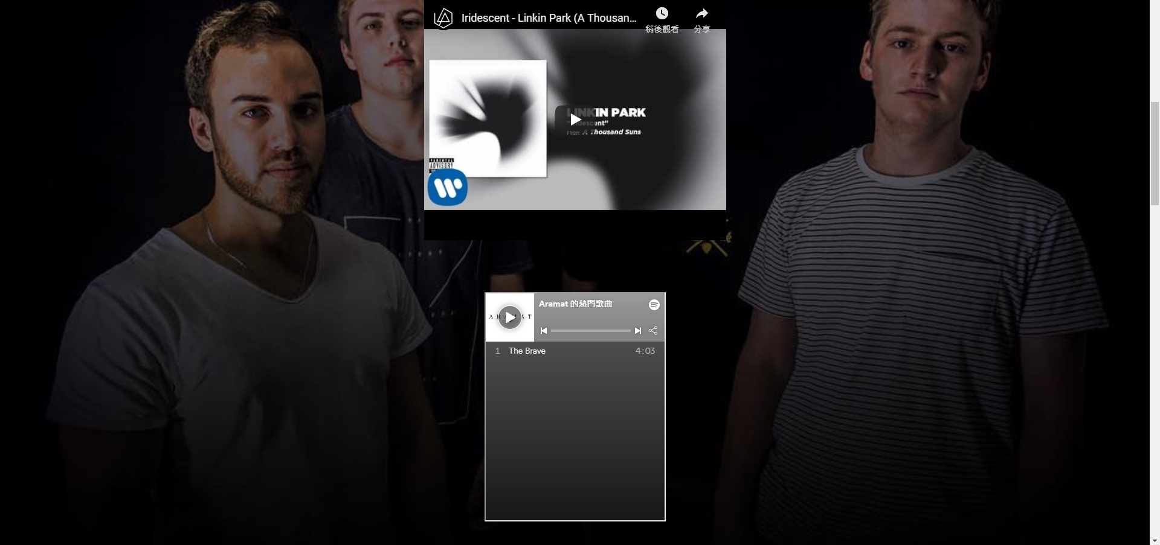
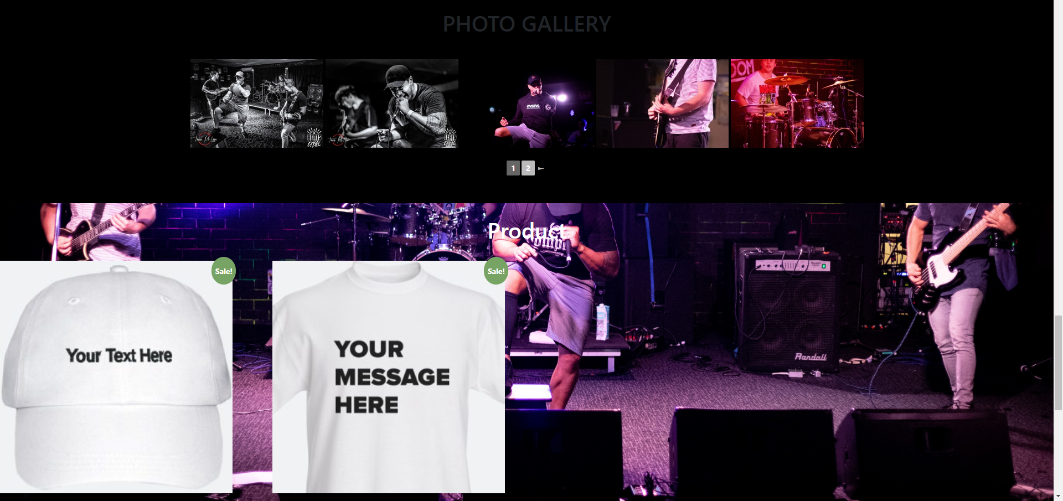
Intro
Milestones / Portfolio

Slide 3
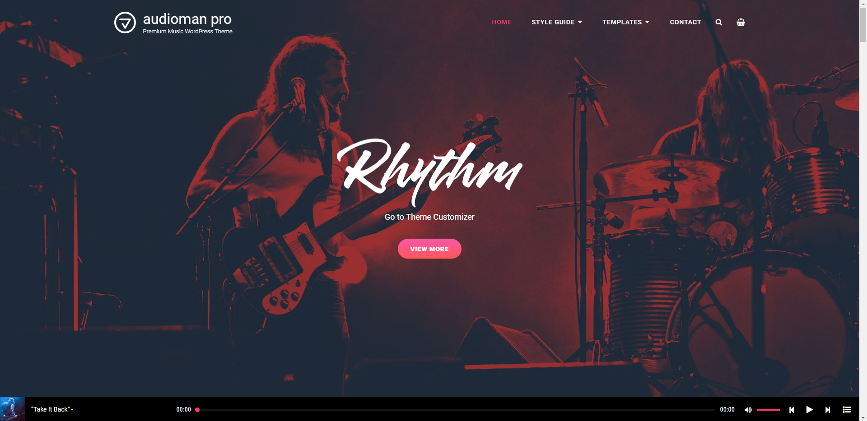
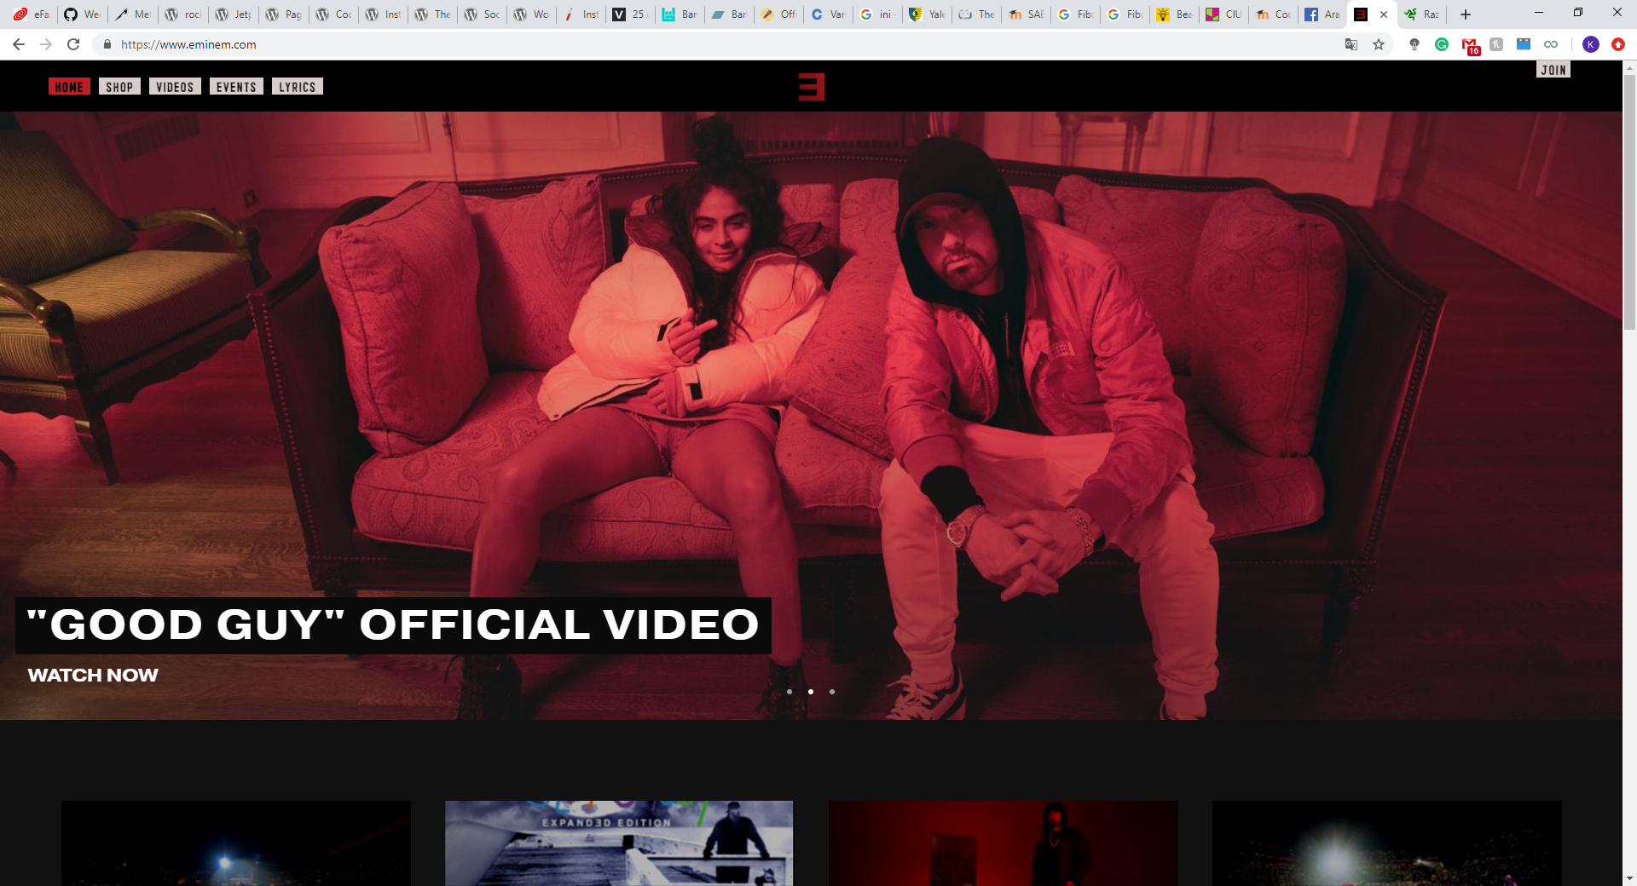
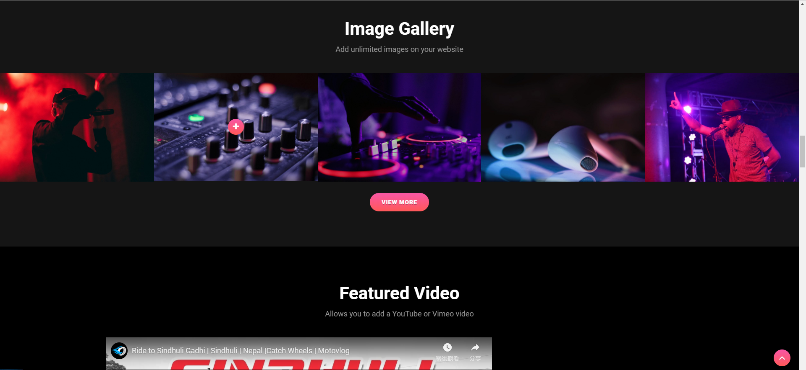
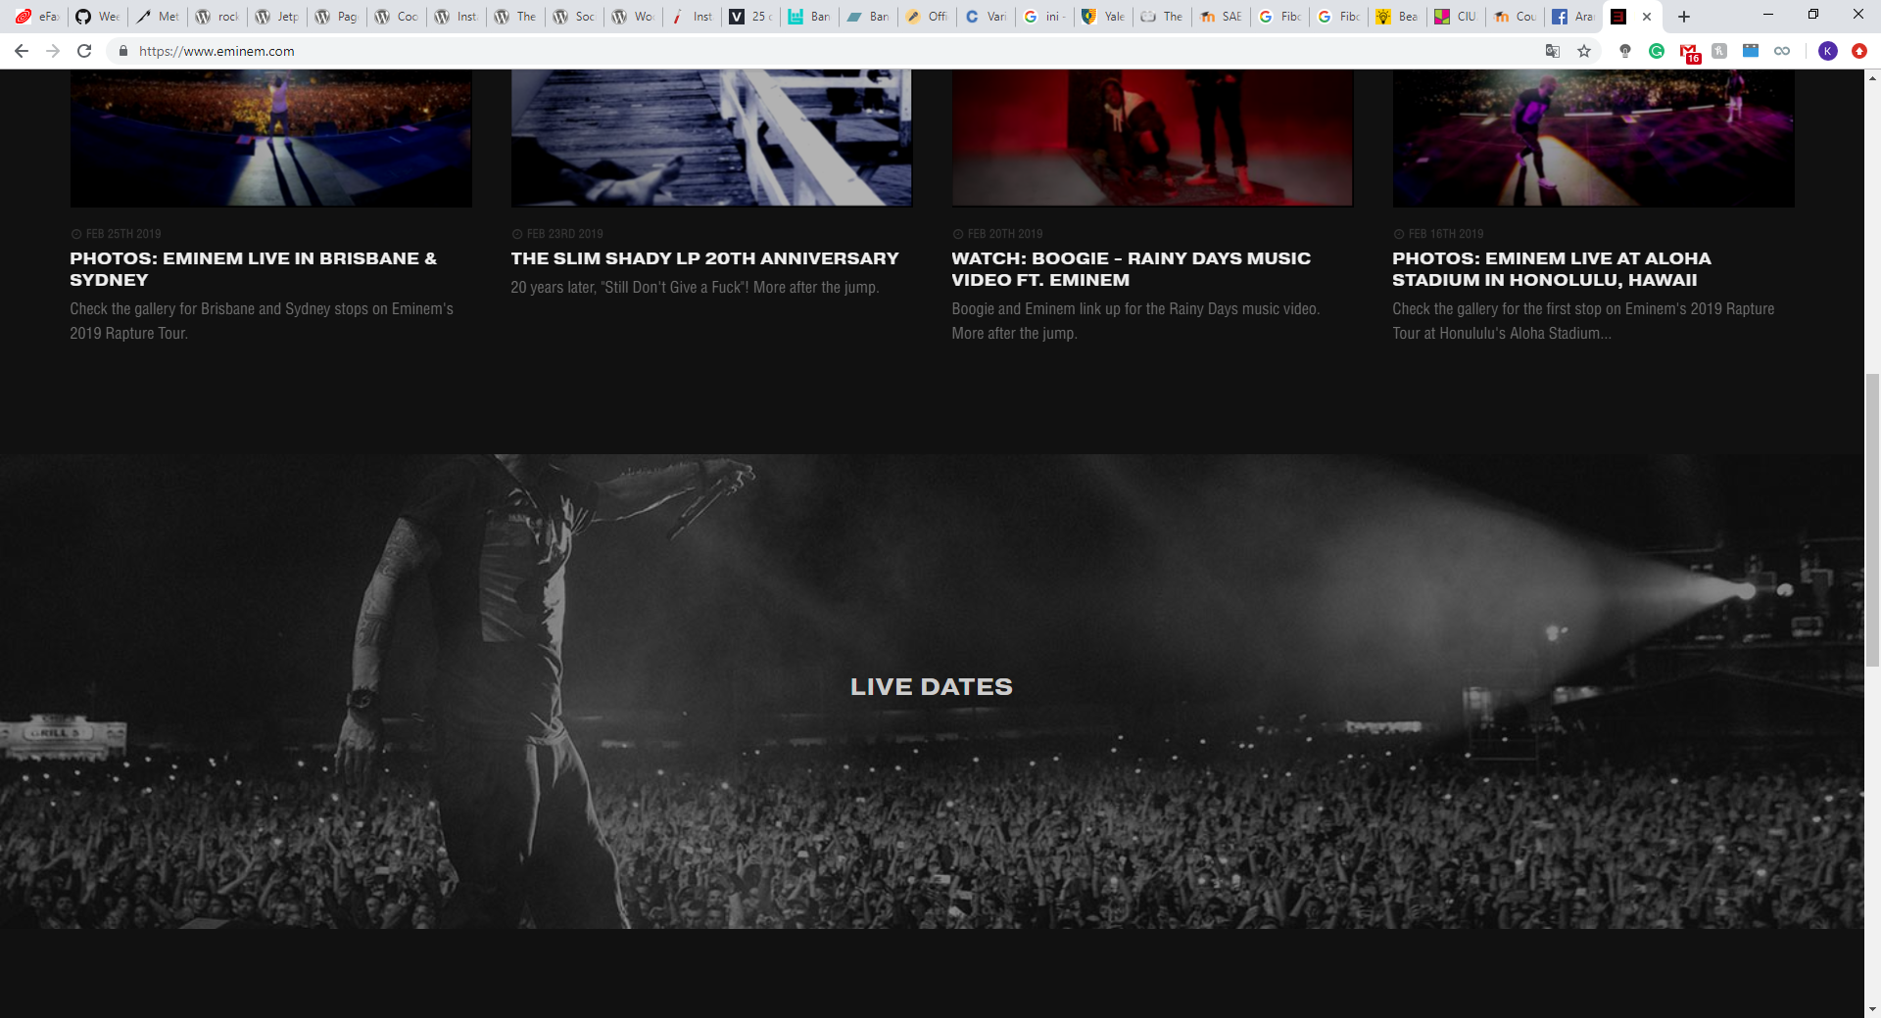
Research
Similar products
https://catchthemes.com/demo/audioman-pro
https://www.eminem.com/

Slide 4
Research
Layout and Design/
Techniques
W3school:
https://www.w3schools.com/howto/howto_css_parallax.asp
https://www.w3schools.com/html/html_responsive.asp
Youtube Tutorial (Theme)
Github/ Stackoverflow/ Wpbeginner (Wordpress)
Parallax Scrolling
Responsive
Shortcode
Wp function

Slide 5
Research
Elements for each section / Plugin
Song/ Video:
Developer.spotify (play button): https://developer.spotify.com/documentation/widgets/generate/play-button/
Embed YouTube Videos:https://themeskills.com/make-embedded-youtube-videos-responsive-wordpress/
Member list:
WP Post ID: https://www.tipsandtricks-hq.com/query-or-show-a-specific-post-in-wordpress-php-code-example-44
Event Calendar Plugin: “All-in-One Event Calendar by Time.ly”
Photo Gallery Plugin: “NextGEN Gallery”
Shop Plugin: “WooCommerce” and “WooCommerce Blocks” Option “WooCommerce Google Analytics Integration” and “WooCommerce PayPal Checkout Gateway”
Media post Plugin: “Feed Them Social (Facebook, Instagram, Twitter, etc)”
Song/ Video
Member list
Event Calendar
Photo Gallery
Shop
Media post

Slide 6
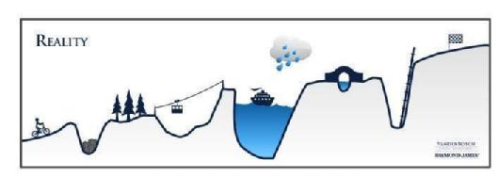
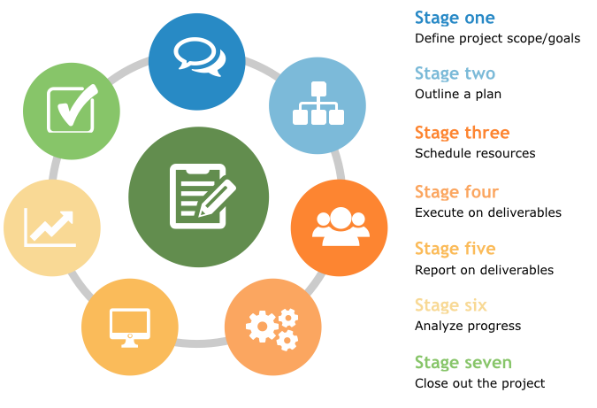
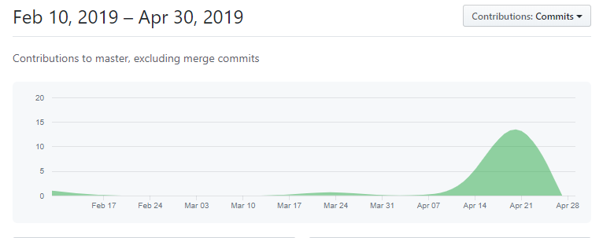
Project management
Expectations
https://savanaradley.files.wordpress.com/2015/01/plan-vs-reality.jpeg
https://github.com/GaryLamKa/DWD200/graphs/contributors
https://software-advice.imgix.net/wordpress/other_pages/Project%20Management/smb-buyerview-2015/1-pm-life-cycle.png

Slide 7
Client conversation/ Feedback
Jack Dowie
Summary:
Week 2-4 : Conform what they want for the website, and ask for more detail information / media.
Week 5-9: (Stop using Online media and meet them after their show) Some more information of others team members and their feedback for the proposal.
Meet their photographer and got some shot of the band.
Week 10-14: No more following conversation

Slide 8






Main programs Used
1
3
Communication: Github/Facebook/In class
Software: Atom, WordPress.org and InstantWP
Collaboration: Github/Google Drive
4
2
5
6

Slide 9
Transferable Skills
Focus on the task and find the right plugin and supporting others in achieving set tasks.
Take challenges as learning and let go if thing didn’t work as planned
Strong Work Ethic
Positive Attitude
Effective Communication Skills
Time Management Skills
Problem Solving Skills
Acting as a Team Player
Self Confidence
Flexibility / Adaptability
Working Well Under Pressure
Still working on it, we did well on giving feedback
The plan didn’t work as expected from the start but it getting clearer when less task
With positive attitude, we breakdown the problems and most of the time we found a workable solutions
Open mind to accept suggestions and give supporting information to help others task
We identified our problems and changed the plan for how can we finish the work
We sees challenges as an opportunity for improvements and able to revisit work plans or goals in line with changed expectations.
Stay positive and don’t give up

Slide 10
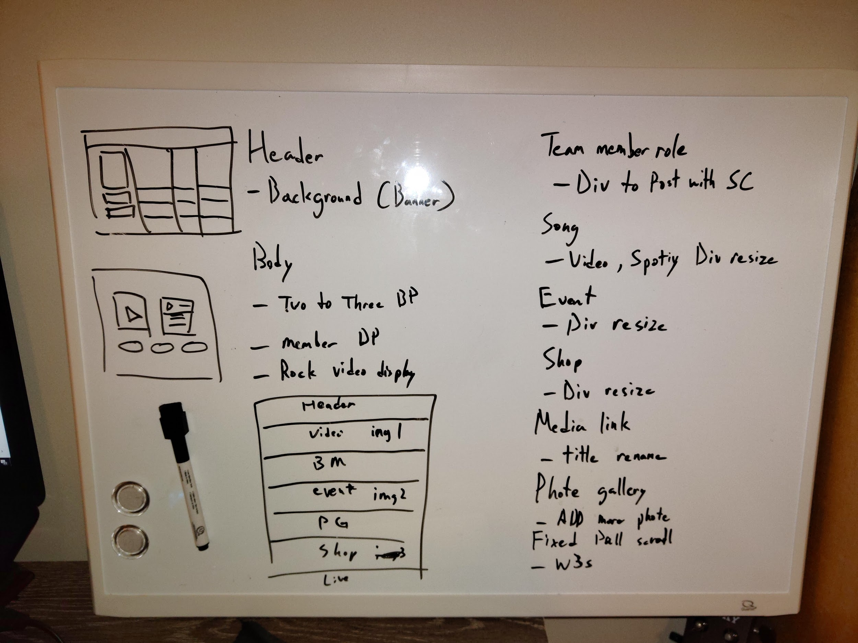
Overview (Gary)
What I learn this trimester :
Wordpress
Real world project experience
The important of transferable skills
The limit for this project:
Myself
Future plan:
Learn from mistake
Communicate with the team

Slide 11

Self Evaluation - Madeliene
Learned
How to use instant Wordpress
My Future plan to Work on
Backup stuff
Documentation skills
Communication skills
Get Better at Time Management

Slide 12

Overview (Madeliene)
The journey that I went through this project I was stressful and at times I felt I was going in blind, but I am happy and relieved that this project is done and was able to produce end of product. This project wasn’t easy for me as the key to Collaboration was communication something I struggle and find daunting but for someone who suffers with autism, I was proud of how well I did in that aspect which I was very surprised on and glad. Overall I am thankful to Gary as I would not have been able to get over the line without him, we would not have had a finished product without his help.

Slide 13
Ref.
Image used
https://encrypted-tbn0.gstatic.com/images?q=tbn:ANd9GcShNyvoSHneZLiE061T8SteOgp2OnpnZWbfnkTofWZQCMM0XOGC
https://upload.wikimedia.org/wikipedia/commons/thumb/7/75/Google_Drive_Logo.svg/1184px-Google_Drive_Logo.svg.png
https://github.githubassets.com/images/modules/logos_page/GitHub-Logo.png
https://cdn.freebiesupply.com/logos/large/2x/facebook-messenger-white-logo-png-transparent.png
https://instantwp.com/wp-content/uploads/2017/10/logo-with-shadow.png
https://s.w.org/style/images/about/standard.png

Slide 14
Timeline

